Slide 1


Introduction to Azure Multi-Factor Authentication (MFA)
Azure Multi-Factor Authentication (MFA) is a powerful security feature provided by Microsoft Azure that adds an extra layer of protection to user sign-ins and transactions. By requiring users to provide two or more forms of authentication, Azure MFA helps prevent unauthorized access and safeguard your organization's sensitive data and resources. This introduction will provide an overview of the benefits of Azure MFA and guide you through the process of enabling, configuring, and managing it within your Azure environment.

Slide 2
Understanding the Benefits of Azure MFA
Improved Security
Reduced Risk of Breaches
Compliance and Regulatory Requirements
Azure MFA enhances security by requiring users to provide additional verification, such as a one-time code sent to their mobile device or a biometric factor like fingerprint or facial recognition. This makes it much harder for attackers to gain unauthorized access, even if they have the user's password.
By adding an extra layer of authentication, Azure MFA significantly reduces the risk of successful phishing attacks, password guessing, and other common tactics used by cybercriminals to gain access to your organization's sensitive data and resources.
Many industries have strict regulations and standards, such as HIPAA, PCI-DSS, and GDPR, that mandate the use of multi-factor authentication. Azure MFA helps organizations meet these compliance requirements and mitigate the risk of hefty fines and penalties.

Slide 3

Enabling Azure MFA for Your Organization
1
Enabling Azure MFA
The first step is to enable Azure MFA within your Azure Active Directory (Azure AD) tenant. This can be done through the Azure portal, where you can configure the necessary settings and policies to enforce multi-factor authentication for your users.
2
Configuring Authentication Methods
Azure MFA supports a variety of authentication methods, including SMS, phone calls, mobile app notifications, and hardware security keys. You can configure which methods are available to your users and set policies to ensure they use the most secure options.
3
Rollout and User Adoption
Once Azure MFA is enabled, you'll need to plan for a gradual rollout to your user base. This may involve user education, communication, and providing support to ensure a smooth transition and high user adoption rates.

Slide 4

Configuring Azure MFA Settings
Authentication Methods
Conditional Access Policies
Customize the available authentication methods for your users, such as SMS, phone calls, mobile app notifications, and hardware security keys. You can also set policies to enforce the use of more secure methods.
Use Conditional Access policies to apply Azure MFA requirements based on factors like user location, device, application, or risk level. This allows you to balance security and user experience based on your organization's specific needs.
Fraud Alert Settings
Reporting and Monitoring
Configure fraud alert settings to allow users to report suspicious sign-in attempts. This can help you quickly identify and mitigate potential security breaches, as well as provide valuable insights for improving your Azure MFA implementation.
Enable detailed reporting and monitoring capabilities to track Azure MFA usage, user activities, and potential security incidents. This information can help you optimize your MFA implementation and ensure compliance with relevant regulations.

Slide 5

Implementing Azure MFA for Users
1
User Enrollment
2
Self-Service Password Reset
Implement a user enrollment process that guides your employees through the setup of their preferred authentication methods, such as mobile app, SMS, or voice calls.
Enable self-service password reset functionality, which allows users to securely reset their passwords using Azure MFA, reducing the burden on your IT helpdesk.
3
Seamless User Experience
4
User Education and Training
Optimize the Azure MFA user experience by providing clear instructions, offering alternative authentication methods, and minimizing disruptions to productivity.
Invest in user education and training to help your employees understand the importance of Azure MFA and how to use it effectively, fostering a security-conscious culture.

Slide 6
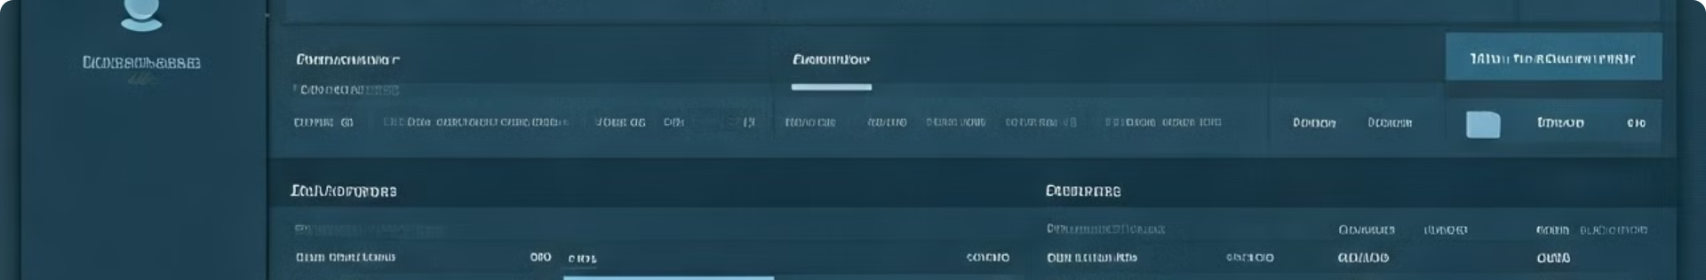




Managing Azure MFA User Settings
Account Settings
User Groups
Reporting and Auditing
User Support
Administrators can manage user account settings, such as enabling or disabling Azure MFA, resetting authentication methods, and troubleshooting user issues.
Organize users into groups and apply Azure MFA policies based on their roles, locations, or other organizational attributes to streamline management and enforcement.
Provide dedicated support resources, such as a self-service portal or IT helpdesk, to assist users with Azure MFA-related issues and facilitate a smooth user experience.
Generate detailed reports on Azure MFA usage, authentication activities, and security incidents to monitor compliance, identify trends, and optimize the implementation.

Slide 7




Troubleshooting Azure MFA Issues
Connectivity Issues
Ensure users have a stable internet connection to successfully authenticate with Azure MFA. Troubleshoot any network or firewall-related problems that may be preventing MFA requests from being processed.
Authentication Method Failures
Investigate issues with specific authentication methods, such as SMS or push notifications, and provide users with alternative options or guide them through the re-enrollment process.
User Enrollment Errors
Assist users who encounter problems during the initial enrollment process, ensuring they can successfully set up their preferred authentication methods and gain access to the required resources.

Slide 8
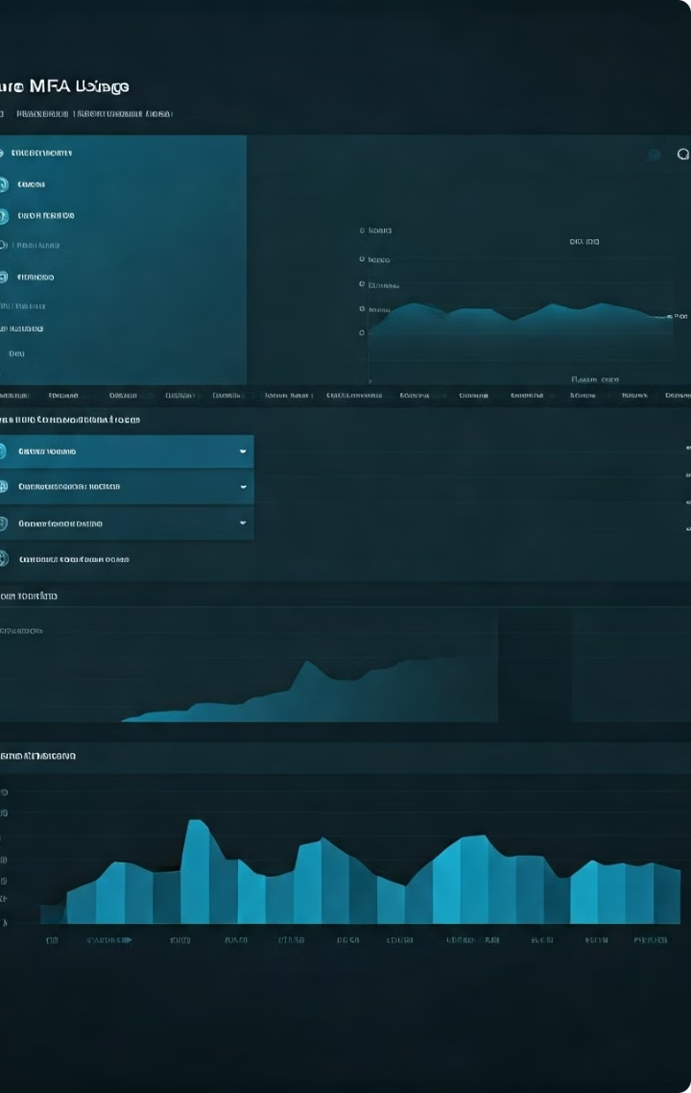
Reporting and Monitoring Azure MFA Usage
Metric
Description
Importance
Authentication Attempts
Track the number of successful and failed authentication attempts, including the methods used.
Identify security trends, optimize authentication policies, and detect potential breaches.
User Activity
Monitor user sign-in behavior, including locations, devices, and applications accessed.
Ensure compliance, detect suspicious activities, and assess the impact of Azure MFA implementation.
Fraud Detection
Analyze reports on fraudulent sign-in attempts and user-reported incidents.
Quickly respond to security incidents, improve fraud detection capabilities, and enhance user trust.
Adoption Rates
Track user enrollment and engagement with Azure MFA, including opt-out rates.
Measure the success of your Azure MFA rollout, identify areas for improvement, and promote best practices.

Slide 9
Securing Access to Azure Resources with Azure MFA
Azure AD-Integrated Applications
Hybrid and On-Premises Resources
Privileged Access Management
Azure MFA can be seamlessly integrated with various Azure AD-connected applications, including Office 365, Azure Portal, and custom web apps, to enforce multi-factor authentication and protect sensitive data and resources.
Azure MFA can also be extended to secure access to on-premises applications and resources, such as virtual private networks (VPNs), remote desktop services, and legacy systems, ensuring a consistent security posture across your IT infrastructure.
Require Azure MFA for users with elevated privileges, such as global administrators or security specialists, to add an extra layer of protection for your most sensitive and critical resources, preventing unauthorized access and abuse of power.

Slide 10

Conclusion and Key Takeaways
1
Enhanced Security
Azure MFA significantly improves the security of your organization by requiring multiple forms of authentication, effectively mitigating the risk of password-based attacks and unauthorized access to critical resources.
2
Compliance and Regulatory Alignment
Implementing Azure MFA helps your organization meet various compliance requirements and industry standards, reducing the risk of hefty fines and penalties associated with security breaches.
3
Improved User Experience
By offering a variety of authentication methods and providing a seamless user experience, Azure MFA can be implemented without significantly disrupting employee productivity or creating user frustration.
4
Comprehensive Management and Reporting
The robust management and reporting capabilities of Azure MFA enable administrators to closely monitor usage, identify security trends, and continuously optimize the implementation to meet the organization's evolving needs.

